Slide 1
The concept of a project life cycle
Grzegorz Gronkiewicz
Radosław Całka

Slide 2
What is the purpose of having a project life cycle?
To define the activities to be carried out in a systems development project.
To introduce consistency among many systems development projects in the same organization.
To provide checkpoints for management control for go/no-go decisions.

Slide 3
The classical project life cycle
The survey phase and the analysis phase may be lumped together into a single phase (this is especially common in organizations in which anything the user wants is deemed at the outset to be feasible).
There may not be a phase called hardware study if it can be taken for granted that any new system can be implemented on an existing computer without causing any major operational impact.
The preliminary design and detail design phases may be lumped together in a single phase simply called design.
Several of the testing phases may be grouped together into a single phase; indeed, they may even be included with coding.

Slide 4
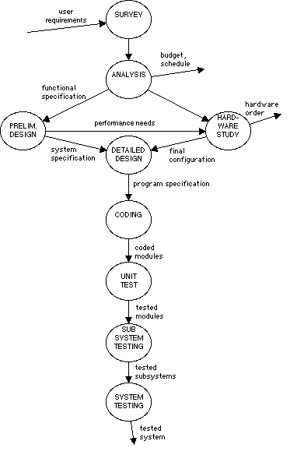

Slide 5

Bottom-Up Implementation
Nothing is done until it's all done.
Module testing uncovers relatively simple logic errors inside individual modules.
Debugging tends to be extremely difficult during the final stages of system testing.
The requirement for computer test time usually rises exponentially during the final stages of testing.

Slide 6
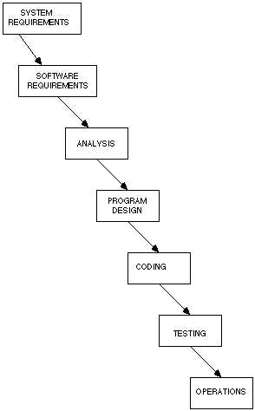

Slide 7
Sequential Progression
sequential approach doesn't allow for real-world phenomena having to do with personnel
we rarely do a complex job right the first time, but we are very good at making repeated improvements to an imperfect job
the user may change his or her mind about what the system should do
the classical project life cycle relies on outdated techniques

Slide 8
The semi structured life cycle
The bottom-up sequence of coding, module testing, and system testing is replaced by top-down implementation
Approach where high-level modules are coded and tested first, followed by the lower-level, detailed modules.
Strong indication that structured programming is to be used as the method of actually coding the system.
Classical design is replaced by structured design.

Slide 9
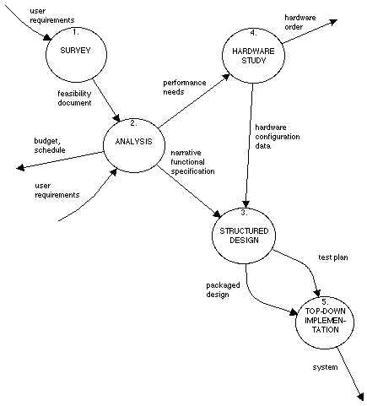

Slide 10
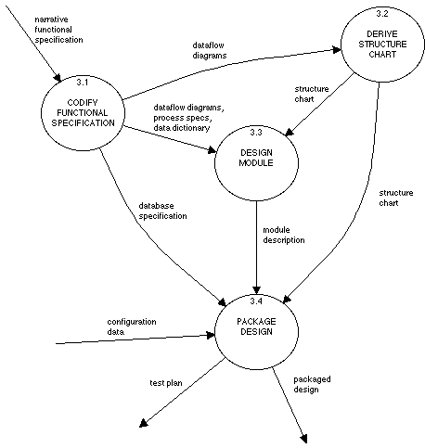

Slide 11
The structured project life cycle
The Survey
Systems Analysis
Design
Implementation
Acceptance Test Generation
Quality Assurance
Procedure Description
Database Conversion
Installation

Slide 12
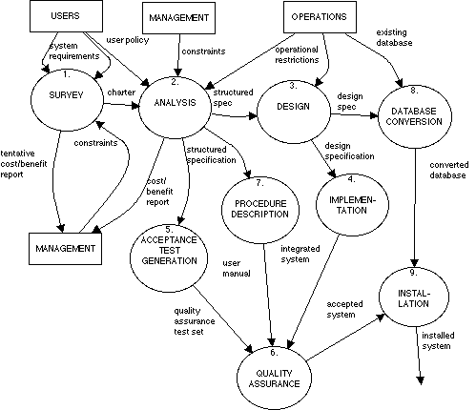

Slide 13

Radical versus conservative top-down implementation
In the most extreme situation, all the activities in the structured project life cycle could be taking place simultaneously
in a conservative approach to the structured project life cycle, all of activity N is completed before activity N + 1 begins.

Slide 14
How does a project manager decide whether to adopt a radical or conservative approach?
How fickle is the user?
What pressure is the project team under to produce immediate, tangible results?
What pressure is the project manager under to produce an accurate schedule, budget, and estimate of people and other resources?
What are the dangers of making a major technical blunder?

Slide 15
The Prototyping life cycle
An alternative approach to requirements definition is to capture an initial set of needs and to implement quickly those needs with the stated intent of iteratively expanding and refining them as mutual user/developer understanding of the system grows

Slide 16
Good candidates for a prototyping approach
The user is unable (or unwilling) to examine abstract paper models like dataflow diagrams.
The user is unable or unwilling to articulate (or “prespecify”) his or her requirements in any form and can only determine the requirements through a process of trial and error.
The system is intended to be on-line with full-screen terminal activities, as opposed to batch edit, update, and report systems.

Slide 17
